Slide 1

The Building Blocks to Creating Good Disciples in Each Generation
Stewardship Education Meeting
Winter, 2015
Office of Stewardship and Development
1400 N. Meridian Street, Indianapolis, IN 46202

Slide 2

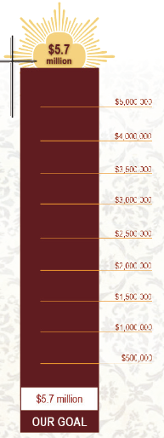

Slide 3


Slide 4

Four
Generations
Post Vatican II
Generation Y
1983 - 2002
Post Vatican II
Generation X
1965 - 1982
Vatican II
PreVatican II
Baby Boomers
1941 - 1960
Greatest
Generation
1940 or before

Slide 5

Six Doors
Campus and young adult ministry
Ministry to married couples and families
Ministry to migrants
Prison ministry
Debt relief
Global Catholicism

Slide 6
“There are some bright spots including the ‘new faithful’ who are often young adults, who exhibit a true vibrancy and are assertively Catholic.”
Archdiocese of Indianapolis preparatory document for the
2012 Synod on the New Evangelization

Slide 7
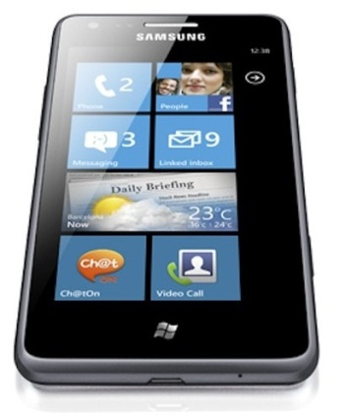



Generational
Differences

Slide 8
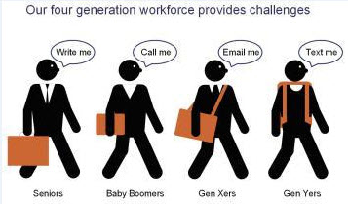

Slide 9
The Greatest Generation
Considered lower class and outsiders.
Church was their refuge, thus high levels of participation.
Believed Catholic Church was the one true church.
Clergy had ultimate authority of faith and morals.

Slide 10
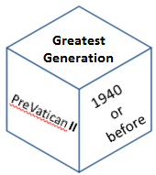
Government and Catholic Church were generally well respected.
61% believe “Catholicism contains a greater share of truth than other religions do.”
Possess highest religious illiteracy in explaining their faith.

Slide 11
Key Attributes Summarized
 | PreVatican II (1940 or before) | Vatican II –Baby Boomers (1941 – 1960) | Post Vatican II – Generation X (1965-1982) | Post Vatican II – Generations X & Y (1983-2002)
Core Values | Respect for Authority
Family | Traditional Nuclear
Education | A dream
Communication Media | Rotary phones One-on-one Write a Memo
Dealing with Money | Put it away Pay Cash
Motivated by | Being Respected
Work/Life Balance | Keep them Separate
Technology is… | Hoover dam

Slide 12
Baby Boomers
Considered middle class with some insiders and some outsiders.
Considered the most valuable generation for marketers.
More philanthropic.
View Church as the People of God.
Laity takes more responsibility for their faith as Church leaders lose control over laity.

Slide 13
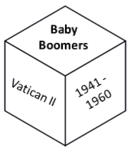
Influenced by government activities and by dramatic changes as result of Vatican II and reaffirmation of traditional teaching on birth control and abortion.
Expect a larger role in Church decision-making processes.
“Place of Worship” is their top priority cause.

Slide 14
Key Attributes Summarized
 | PreVatican II – (1940 or before) | Vatican II –Baby Boomers (1941 – 1960) | Post Vatican II – Generation X (1965-1982) | Post Vatican II – Generations X & Y (1983-2002)
Core Values | Respect for Authority | Optimism Involvement
Family | Traditional Nuclear | Disintegrating
Education | A dream | A birthright
Communication Media | Rotary phones One-on-one Write a Memo | Touch-tone phones Call me anytime In-person
Dealing with Money | Put it away Pay Cash | Buy now, pay later
Motivated by | Being Respected | Being valued and needed
Work/Life Balance | Keep them Separate | No balance “live to work”
Technology is… | Hoover dam | The microwave

Slide 15
Consider these talking points…
What words do you use when describing these generations?
Based on the noted characteristics, is there a better way to engage these individuals as stewards?
What does your parish do to help people within these generations deepen their prayer life and better understand the depth of Church teachings?
Are there opportunities to better utilize these two generations in the New Evangelization?

Slide 16
Generation X
Considered upper-middle class and insiders,
Grew up “latch-key” kids, street-smart, and often isolated.
Entrepreneurial and very individualistic; often cynical of many major institutions.
More fully integrated into American society and comfortable with American culture of individualism and voluntarism.

Slide 17
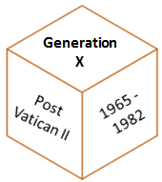
Church participation declined as doctrinal differences became more pronounced.
Influenced more by popular culture while increasingly indifferent to the role of the Church in their lives.

Slide 18
Key Attributes Summarized
 | PreVatican II – (1940 or before) | Vatican II –Baby Boomers (1941 – 1960) | Post Vatican II – Generation X (1965-1982) | Post Vatican II – Generations X & Y (1983-2002)
Core Values | Respect for Authority | Optimism Involvement | Skepticism Fun Informality
Family | Traditional Nuclear | Disintegrating | Latch-key kids
Education | A dream | A birthright | A way to get there
Communication Media | Rotary phones One-on-one Write a Memo | Touch-tone phones Call me anytime In-person | Cellphone Call me only at work Direct Immediate
Dealing with Money | Put it away Pay Cash | Buy now, pay later | Cautious Conserative Save, Save, Save
Motivated by | Being Respected | Being valued and needed | Freedom and removal of rules
Work/Life Balance | Keep them Separate | No balance “Live to work” | Balance “Work to live”
Technology is… | Hoover dam | The microwave | What you can hold in your hand: PDA, Cell

Slide 19
Generation Y or Millennials
Also considered upper-middle class and insiders though the overall rate of upward mobility is slowing.
Highly integrated into American society and highly assimilated into its pro-individual, pro-choice culture.
Worldview defined by 9/11 and globalization.
Multicultural and internationalist in outlook and socially tolerant.
Church participation has further declined as doctrinal differences become even more pronounced.

Slide 20
Far more likely to seek transparency and accountability with causes they choose to support. Seek measurable impact.
Less dependent on the Church with increasing emphasis on conscience as the focus of authority; Less Church involvement – more influenced by pop culture.
Most like being Catholic & cannot see themselves being anything other than Catholic though they are not sure what is distinctive about Catholicism and what their Catholic heritage really means.
Generation
Y
Post Vatican II
1983 - 2002

Slide 21
Majority see the sacraments and devotion to Mary as essential to the Catholic faith. Less attached to the Church and less likely to participate in sacraments and traditional devotional practices.
Most consider themselves spiritual, pray regularly, and support the Church’s social mission.
Only 43% believe “Catholicism contains a greater share of the truth than other religions do”.
Less religious in childhood; report fewer experiences of God’s presence in their lives; less committed to the Church.
Generation
Y
Post Vatican II
1983 - 2002

Slide 22
Generation least inclined to maintain traditional faith practices and morals. Believe Catholicism is more a matter of personal option.
They wait longer to marry; therefore, experience longer periods of disconnectedness from the Church.
Most likely to donate their money and volunteer their time and talents.
Higher tendency to recommend causes and organizations to others. Not afraid to use knowledge of their own generation and technology to evangelize.
Generation
Y
Post Vatican II
1983 - 2002

Slide 23
Top priority cause: “Supporting a mission or cause that fits with personal values”.
Most apt to use an organization’s website when searching for information on a cause or organization. More likely to give online.
Generation
Y
Post Vatican II
1983 - 2002

Slide 24
Key Attributes Summarized
 | PreVatican II – (1940 or before) | Vatican II –Baby Boomers (1941 – 1960) | Post Vatican II – Generation X (1965-1982) | Post Vatican II – Generations X & Y (1983-2002)
Core Values | Respect for Authority | Optimism Involvement | Skepticism Fun Informality | Realism Confidence Extreme fun Social
Family | Traditional Nuclear | Disintegrating | Latch-key kids | Merged Families
Education | A dream | A birthright | A way to get there | An incredible expense
Communication Media | Rotary phones One-on-one Write a Memo | Touch-tone phones Call me anytime In-person | Cellphone Call me only at work Direct Immediate | Internet Picture Phones Email Voicemail
Dealing with Money | Put it away Pay Cash | Buy now, pay later | Cautious Conserative Save, Save, Save | Earn to spend
Motivated by | Being Respected | Being valued and needed | Freedom and removal of rules | Working with other bright people
Work/Life Balance | Keep them Separate | No balance “Live to work” | Balance “Work to live” | Balance – it’s 5 p.m. – I’ve got another gig
Technology is… | Hoover dam | The microwave | What you can hold in your hand: PDA, Cell | Ethereal - intangible

Slide 25
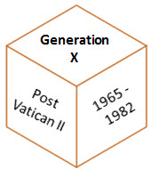
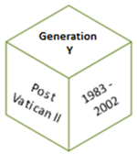
Consider these talking points…
What words do you use when describing these generations?
Based on the noted characteristics, is there a better way to engage these individuals as stewards?
What does your parish do to help people within these generations deepen their prayer life and better understand the depth of Church teachings?
Are there opportunities to better utilize these two generations in the New Evangelization?

Slide 26

How do we become the
“Church of Mercy” to all generations?

Slide 27
The Church must be sensitive to not just generational differences but also to intercultural differences.

Slide 28
Hispanics in the U.S. Catholic Church
Since 1960 Hispanics have accounted for 71% of the growth of the Catholic Church in the U.S.
Today, 40% of all U.S. Catholics are registered Hispanics and 76% of all Hispanics consider themselves Catholic.

Slide 29
Again, consider these talking points…
What words do you use when describing these generations?
Based on the noted characteristics, is there a better way to engage these individuals as stewards?
What does your parish do to help people within these generations deepen their prayer life and better understand the depth of Church teachings?
Are there opportunities to better utilize all generations working together in the New Evangelization?

Slide 30
Synod of Bishops XIII Ordinary General Assembly
The New Evangelization for the Transmission of the Christian Faith, Lineamenta, no. 10
A new evangelization is synonymous with mission, requiring the capacity to set out anew, go beyond boundaries and broaden horizons. The new evangelization is the opposite of self-sufficiency, a withdrawal into oneself, a status quo mentality and an idea that pastoral programs are simply to proceed as they did in the past. Today, a “business as usual” attitude can no longer be the case. Some local Churches, already engaged in renewal, reconfirm the fact that now is the time for the Church to call upon every Christian community to evaluate their pastoral practice on the basis of the missionary character of their programs and activities.

Slide 31
We Can Help
Tools for You to Use
Defining Roles and Developing Stewardship Committees
Conducting a Parish Renewal Program
Developing Parish Renewal Resources and Timelines
Determining best-practices in Stewardship and Development Topics
Information specific to the United Catholic Appeal
Guidelines for Feasibility and Capital Campaigns, including the Archdiocesan Approval Process
Education Support of Planned Giving Opportunities
Growing and Establishing Permanent Parish, School and Agency Endowments
No Additional Cost Assistance when the parishes, schools and agencies are beneficiaries of estate gifts and bequests
Jolinda Moore, Director
Stewardship and Development
jmoore@archindy.org or (317) 236-1462
Ellen Brunner, Director
Catholic Community Foundation
ebrunner@archindy.org or (317) 236-1427
Ron Greulich, Director
Stewardship Education
rgreulich@archindy.org or (317) 236-1426
Joanna Feltz, J.D.
Director of Planned Giving
jfeltz@archindy.org or (317) 236-1588

